Slide 1
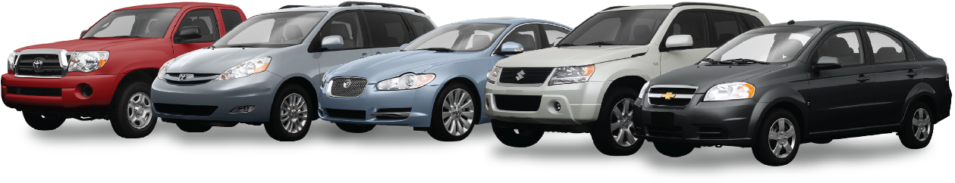

Used car Price predictions
Notes:
Hello everyone, ☺
Today, we’ll be taking a look my Used Car Prediction experiment.

Slide 2

Presentation roadmap
DATASET
AND
ISSUES
START
PROBLEM
SOLUTION
END
TAKEAWAYS
RESULTS
Notes:
During today's presentation we will explore the original problem, changes made along the way, the dataset, solutions and results as well as final takeaways from this experiment.
*wait 2 seconds”

Slide 3



Problem
Looking to buy a used car?
Is the asking price reasonable?
Looking to sell a used car?
How much should you ask?
Research is tiresome and tedious
Use Machine Learning!
Use car characteristics to predict price
Determine the most important factors in price prediction
Notes:
Every year millions of used cars are bought and sold in the US and Canada. Buyers and sellers utilize mediums such as Craigslist, Kijiji and Autotrader to list and discover vehicles for sale in their area. Buyers looking for a used car hope to determine if sellers are asking a reasonable price, while sellers are looking for fair price to sell at. This situation poses a perfect opportunity to use machine learning to solve a real life problem. Using characteristics of a car, such as year, paint colour, model and milage, I hope to predict a price based on previous sales in the area. Thus, buyers and sellers can settle on a fair price for a used vehicle.

Slide 4





Dataset AND issues
Craigslist Used Car Dataset
Manufacturer, Model, Size, Paint Colour, Mileage, Year, Type, State
Scope too large.
Limit to a smaller region.
Close to Ontario
Michigan, New York, New Hampshire, Vermont
Notes:
The data being utilized in this problem will be from the Craigslist Used Car Dataset. This set includes data from used car advertisements on Craigslist from across the United States and can be found on the Kaggle website. The data set includes variables such as manufacturer, model, year, odometer, size, type, paint_color, cylinders and more. The column ‘price’ will be used as the target variable. Since this is a numeric target, we will be using a regressor model.
As work began on this experiment it was quickly realized that the scope was too large. Prices across the country vary incredibly and therefore finding a model that could accurately apply to every state was not plausible. Therefore, I decided to narrow the scope to include only a few states near the Canadian border, so that the model may be easily comparable to Canadian used car data as well. These states included New York, Vermont, Michigan and New Hampshire.

Slide 5


SOLUTION
>2009
Cleaning Data
States
Year
One Hot Encoding
RandomForestRegressor
Parameter Tuning
Feature Importance
Permutation Importance
Notes:
The experiment began by first cleaning up the data file. I dropped any null rows and manipulated the posting date variable from a string to the number of days since posting. I then extracted the data we required to make the model, by taking only rows which had the column variable ‘state’ as New York, Michigan, Vermont of New Hampshire. I also restricted the variable ‘year’ to be anything above 2009. This was because as cars got quite old (such as 1960s or 1970s) the price began to increase again, which negatively impacted the effectiveness model.
In order to preprocess the data, I created pipelines to process the numeric data and the categorical data separately. The numeric columns were checked for missing values and replaced by the mean of the column. Then they were standardized, subtracting the mean and scaling to unit variance. The categorical columns were also checked for missing values and then were OneHotEncoded. This creates binary columns for each categorical label in the column, thus allowing us to use it in the model.
I also decided to use the Random Forest Regressor from sci-kit learn to build the model.
I then tuned the parameters n_estimators and max_depth to arrive upon the final model.
Finally, I used the method eli5 to display the feature imortances, and manually plotted a bar chart for the permutation importances using pyplot.

Slide 6
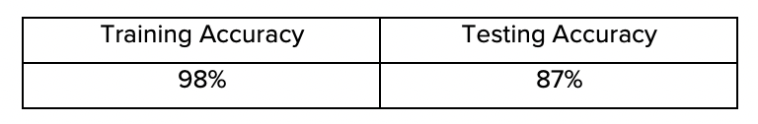
Results
Accuracy
Feature Importances
Permutation Importances
Sample Use Case
Notes:
we can see that both the training accuracy and the testing accuracy were quite good for this model. This was a major improvement from earlier scores where the area had not been specified. These results were approximately 40% training accuracy and 0.1% testing accuracy. After narrowing the scope, the scores improved drastically.

Slide 7
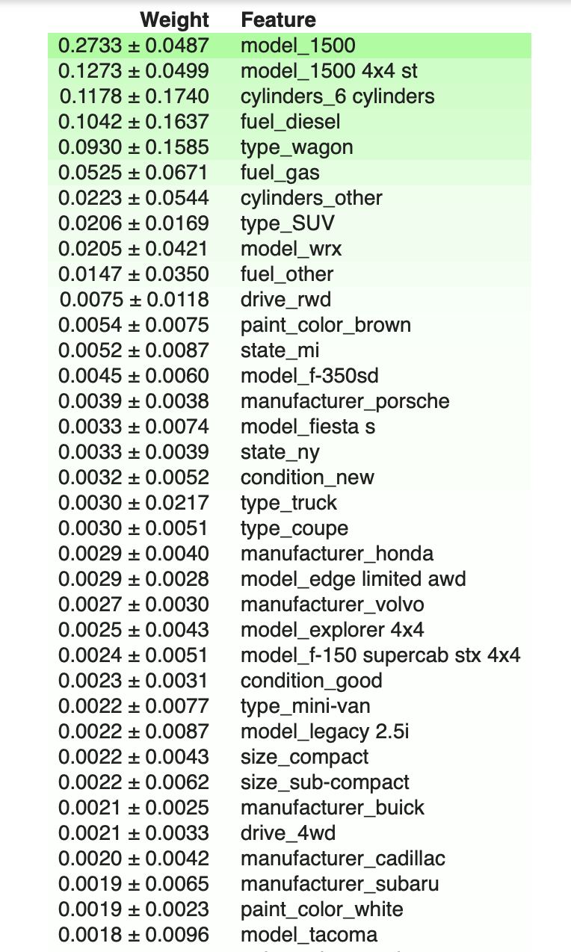
Results
Accuracy
Feature Importances
Permutation Importances
Sample Use Case
Notes:
we can also see some of the most important factors of the model. Interestingly, the model 1500 was one of the most important factors. However, since there are hundreds of factors with minimal importance, it is more beneficial to the permutation importances.

Slide 8
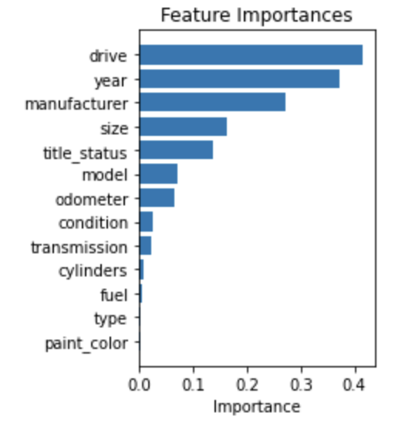
Results
Accuracy
Feature Importances
Permutation Importances
Sample Use Case
Notes:
From this we can see that drive, year, manufacturer and size are the four most important factors. This makes a great deal of sense. In general, SUVs and trucks with four wheel drive are more expensive than smaller cars with only forward wheel drive and larger cars will be much more expensive than smaller cars. Another interesting revelation is that year is much more significant than odometer. This means that mileage is not as important in determining price as one might have thought. Manufacturer is also of high importance which also makes sense, as different companies have different qualities and therefore prices of cars. Additionally, paint colour has a very low significance in determining the price, which is somewhat expected.

Slide 9
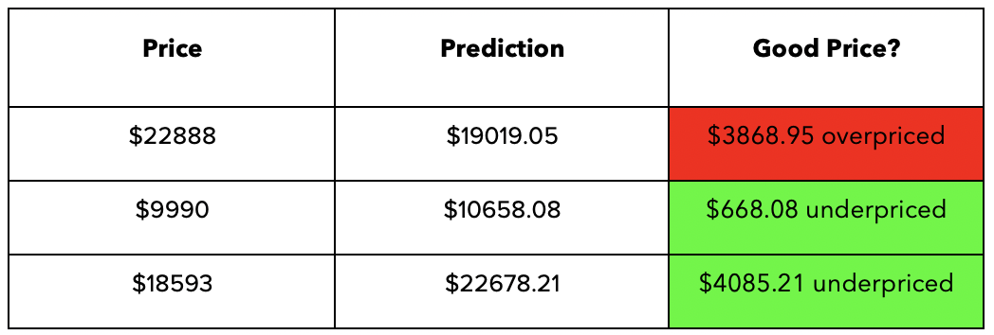
Results
Accuracy
Feature Importances
Permutation Importances
Sample Use Case
Notes:
I also decided to add a sample use case for the model. In table 2 we can see the model’s predictions for a few cars found at autotrader.ca. I have multiplied each prediction by the current exchange rate to compare the prices in Canadian dollars. A buyer can use this number to determine if a certain listing if worth the current asking price.

Slide 10
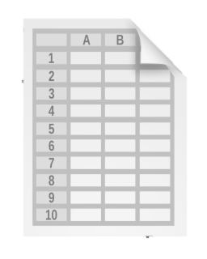


Takeaways
Importance of scope/resolution.
Model took ages to run.
Accuracy was extremely low.
Variables Importances
Year and Manufacturer very important.
Mileage not as significant.
Notes:
There are many important takeaways from this project. First, it has been demonstrated that resolution plays a major role in the success of a model. If the scope of a dataset is too large, and the data is too different, this severely impacts the model’s accuracy. Once a more appropriate area was chosen, the model was very effective in learning the patterns. Clearly, resolution is an important factor that must be considered when investigating a dataset.
Another important take away is the feature importances of the model. It is valuable for sellers to know that odometer(milage) is not as important as many believe. It is also interesting to know that year plays a major role in determining price, even more so than the manufacturer does. All of these facts are valuable to anyone buying or selling a car who is hoping to better understand the current market and why certain vehicles are priced in such a way. Hopefully from this presentation you gained a better understanding of used car prices, and perhaps this may be beneficial to some us looking to get into the market in the near future. Thanks for listening!

Slide 11
References
Christophhm.github.io. Permutation Feature Importance. https://christophm.github.io/interpretable-ml-book/feature-importance.html
Reese, Austin. Used Car Data Vehicle Listings from Craigslist. https://www.kaggle.com/austinreese/craigslist-carstrucks-data
Rebecca Vickery. Extracting Feature Importance from Sci-kit Learn Pipelines. https://towardsdatascience.com/extracting-feature-importances-from-scikit-learn-pipelines-18c79b4ae09a
Sci-kit Learn. Permutation Importance vs Random Forest Feature Importance. https://scikit-learn.org/stable/auto_examples/inspection/plot_permutation_importance.html
Autotrader Canada. https://www.autotrader.ca/cars/subaru/outback/2018/?gclid=Cj0KCQjwse-DBhC7ARIsAI8YcWLaENUcKwObiZwNbo4UiF4MzBr4IXBbCzFg_y6i3i5URLOZIW1Lg6gaArG4EALw_wcB

